Slide 1
ASTHMA DISEASE PREDICTION USING MACHINE LEARNING
SANTA SAJI
S3 MCA
MAC23MCA-2050
Prof. NISHA MARKOSE
Associate Professor
MCA Dept, MACE

Slide 2
CONTENTS
INTRODUCTION
LITERATURE REVIEW 1
LITERATURE REVIEW 2
LITERATURE REVIEW 3
SUMMARY
PROJECT PROPOSAL
DATASET

Slide 3
INTRODUCTION
Asthma, a chronic respiratory condition marked by airway inflammation and bronchoconstriction, poses significant health risks and impacts millions globally.
Early detection and prediction are crucial for effective management and improved patient outcomes.
Machine learning techniques offer powerful tools for analyzing complex datasets to detect and predict asthma.
ML models can identify patterns and risk factors associated with asthma exacerbations.

Slide 4
LITERATURE REVIEW

Slide 5
An Early Detection of Asthma Using BOMLA Detector
1
Introduces a novel machine learning framework, the Bayesian Optimization-based Machine Learning Framework for Asthma (BOMLA) detector, designed to accurately detect asthma at an early stage.
Employs ten different classifiers
ADASYN algorithm has also been employed -eradicate the issues created due to the imbalanced dataset

Slide 6
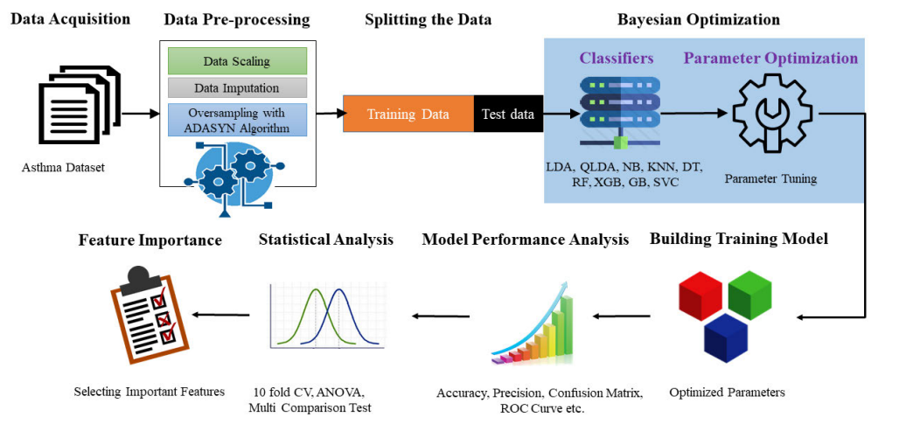
WORKFLOW

Slide 7
DATASET
Consists of clinical data from 389 individuals, including attributes such as AGE, SPO2, PULSE, FEV, FEV_percent, FVC, FVC_percent, FEV1_by_FVC, and MEF2575, collected in Khulna, Bangladesh
90.49% of the samples -asthma positive and 9.61% - asthma negative

Slide 8
ACCURACY
LDA - 54.35 QLDA - 61.30 KNN - 74.35 NB - 57.39 DT - 76.96 XGB - 90.00
GBC - 92.61 ANN - 88.26 SVC - 94.35

Slide 9
Smart Healthcare Framework for Asthma Attack Prediction and Prevention.
2
Presents a comprehensive Smart Healthcare Framework for Asthma Attack Prediction and Prevention.
Framework integrates a multi-layered approach, leveraging diverse data sources, advanced data processing techniques, and robust machine learning models to predict asthma attacks and provide personalized healthcare services
Not only predicts asthma attacks but also offers additional services such as risk level detection, pollution concentration visualization, safe route recommendations, and push notifications.
These services are designed to empower patients and healthcare providers with timely information and actionable insights, ultimately enhancing the quality of asthma care and prevention strategies.

Slide 10
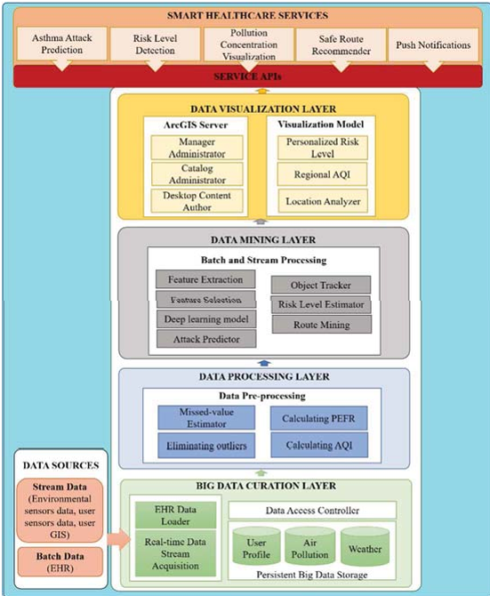
WORKFLOW

Slide 11
DATASET
Dataset used in the framework is a collection of data from various sources.
Includes both real-time and historical data.
1. Environmental Data
Air Quality
Weather
Pollution Concentration.
2. Health Records
Electronic Health Records (EHR):
medical history
medication
allergy information
previous asthma attacks.
Peak Expiratory Flow Rate (PEFR):

Slide 12
3. Real-time Monitoring Data
Wearable Devices
User Sensors:.
4. User GIS Data
Geographical Information System (GIS) Data

Slide 13
ACCURACY
RF
92%
SVM
89%
NN
94%

Slide 14
Machine Learning for Predicting the Risk for Childhood Asthma Using Prenatal, Perinatal, Postnatal and Environmental Factors
3
Aims to identify and analyse the risk factors for childhood asthma using data from a prospective study of 202 children, both asthmatic and non-asthmatic, conducted at the Ibn Sina Hospital Center.
Various ML algo are used to predict asthma occurrence and thus highlighting significant risk factors.
Emphasis is placed on maternal and prenatal factors.

Slide 15
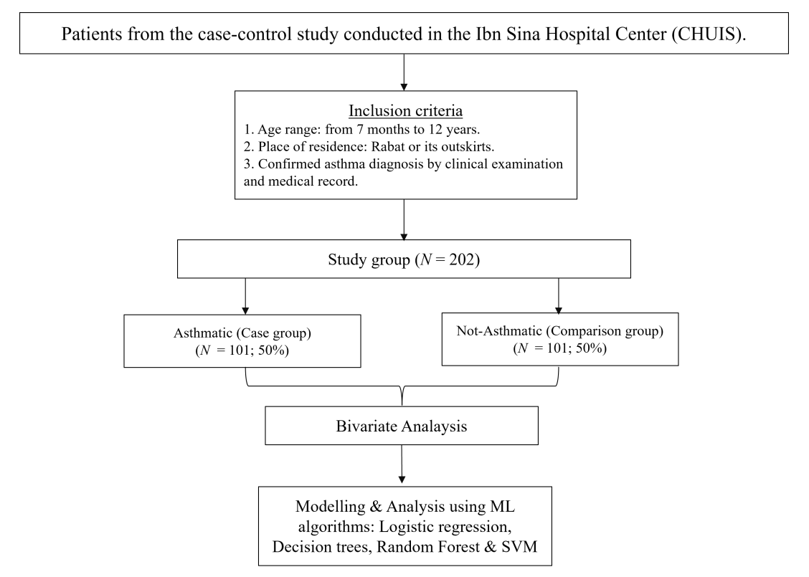
WORKFLOW

Slide 16
DATASET
The dataset includes various binary categorical variables gathered from interviews with the children's mothers.
Variables cover prenatal, perinatal, and postnatal periods, focusing on factors potentially associated with childhood asthma.

Slide 17
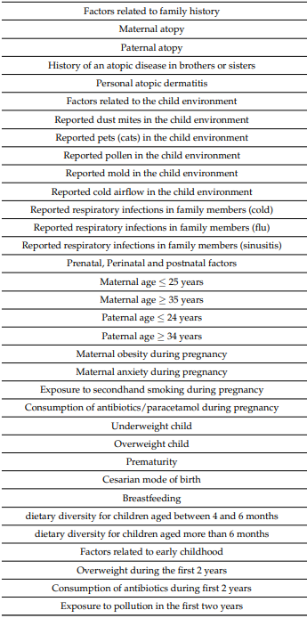

Slide 18
ACCURACY
Random forest yielded the best predictive performance (accuracy = 84.9%), followed by logistic regression (accuracy = 82.57%), support vector machine (accuracy = 82.5%) and decision trees (accuracy = 75.19%)

Slide 19
SUMMARY
TITLE
YEAR
JOURNAL NAME
ACCURACY
PAPER 1
Early Detection of Asthma Using BOMLA Detector
2021
IEEE Access( IEEE )
RF - 90
KNN - 74.35
NB - 57.39
DT - 76.96
XGB - 90.00
GBC - 92.61
ANN - 88.26
SVC - 94.35
Smart Healthcare Framework for Asthma Attack Prediction and Prevention.
2021
National Computing Colleges Conference [NCCC] (IEEE)
RF 92%
SVM 89%
NN 94%
PAPER 2
Machine Learning for Predicting the Risk for Childhood Asthma Using Prenatal, Perinatal, Postnatal and Environmental Factors
RF= 84.9%
LR= 82.57%)
SVM = 82.5%)
DT= 75.19%
PAPER 3
2021
Healthcare(MDPI)

Slide 20
PROJECT PROPOSAL
Comparative study of algorithms
DT
RF
SVM
Why DT ?
Offer simplicity
Better visualisation
Why RF ?
Enhance accuracy and robustness through ensemble learning.
Why SVM ?
Support vector machines excel in high dimensional spaces and maximize classification margins.

Slide 21
PROJECT PROPOSAL
Models will diagnose whether the patient is asthmatic or not.
Predictive tool assesses asthma risk based on user responses, facilitating early detection and personalized healthcare recommendations.
Model aims to enhance asthma management, especially when clinical testing is not readily accessible

Slide 22
DATASET
Dataset is taken from the Kaggle repository.
2393 samples and every sample has 29 features.
Contains numeric values and boolean values.
Includes patient details,demographic details, lifestyle factors, environmental and allergy factors, medical history, clinical measurements, symptoms, and a diagnosis indicator.
https://www.kaggle.com/datasets/rabieelkharoua/asthma-disease-dataset

Slide 23
Identifier - patient_id.
Class label - diagnosis.
Features-age,gender,ethnicity,education_level,bmi,smoking,physical_activity,diet_qualiy,sleep_quality,pollution_exposure,pollen_exposure,dust_exposure,pet_allergy,
family_history_asthma,history_of_allergies,eczema,hay_fever,gastroesophagl_reflux,lung_function_fev1,lung_function_fvc,wheezing,shortness_of_breath,
chest_tightness,coughing,nighttime_symptoms,exercise_induced,doctor_in_
charge.

Slide 24
DATASET ATTRIBUTES
PatientID
Age
Gender
Ethnicity
EducationLevel
BMI
Smoking
PhysicalActivity
DietQuality
SleepQuality
PollutionExposure
DustExposure
PetAllergy
FamilyHistoryAsthma
HistoryOfAllergies
Eczema
HayFever
GastroesophagealReflux
LungFunctionFEV1
PollenExposure
LungFunctionFVC
Wheezing
ShortnessOfBreath
ChestTightness
Coughing
NighttimeSymptoms
ExerciseInduced
Diagnosis
DoctorInCharge

Slide 25
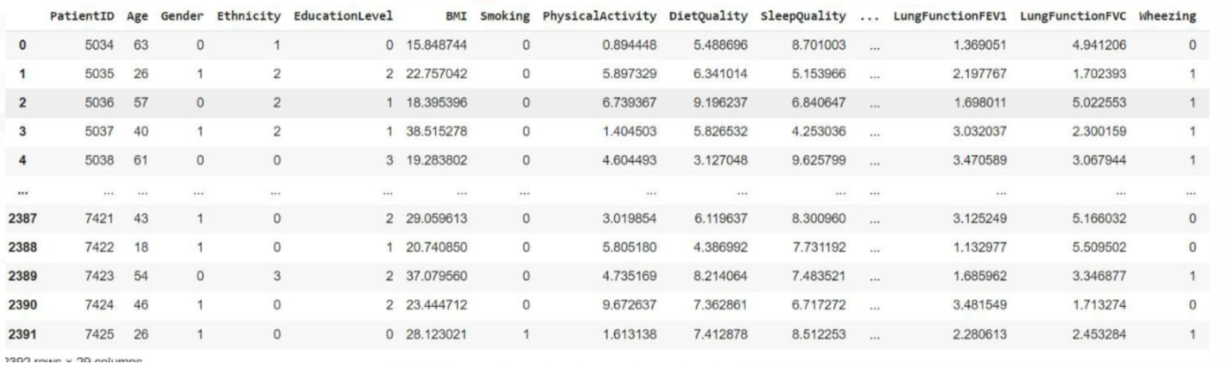
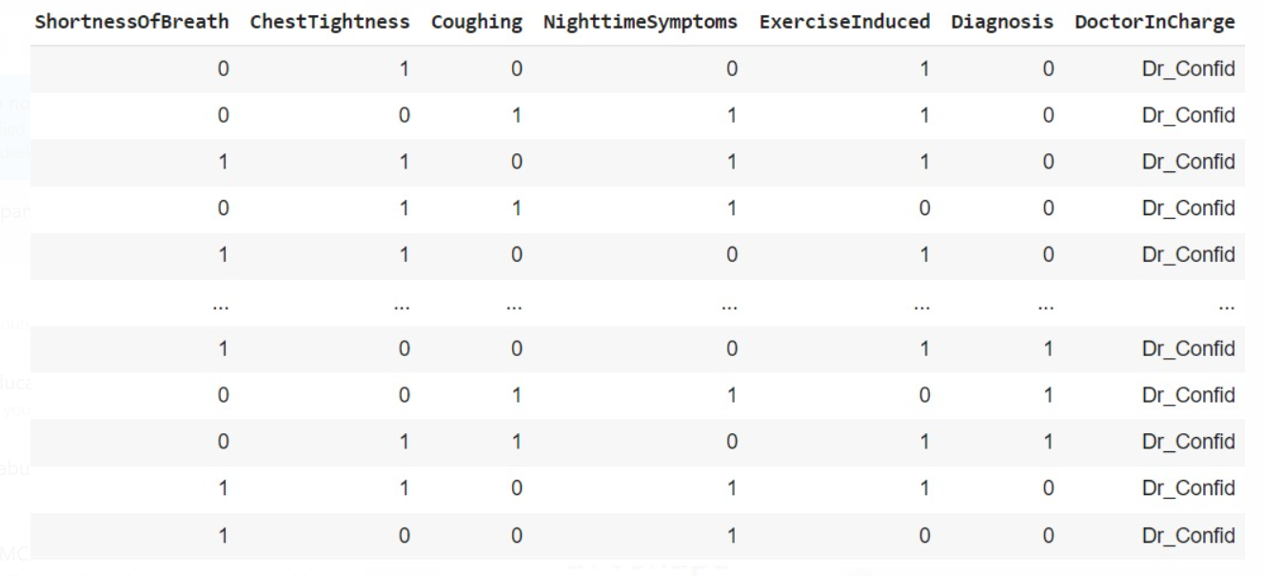
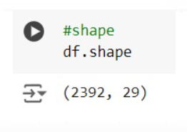
DATASET EXPLORATION
Dataset has 2392 rows and 29 columns

Slide 26
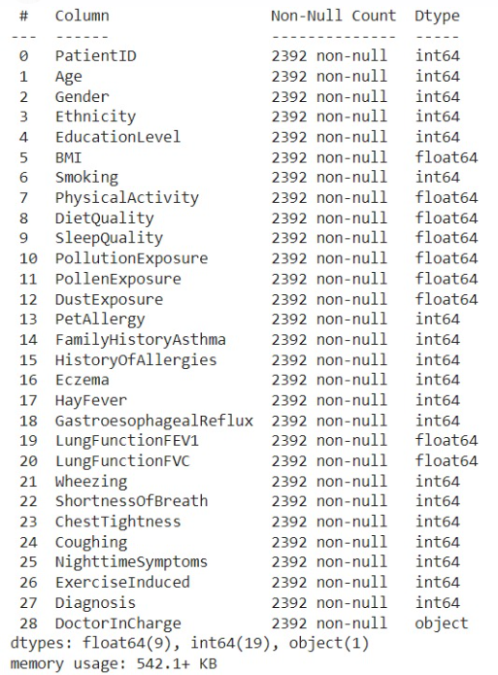
Dataset contains 14 numerical attributes and 15 categorical attributes including target class.

Slide 27
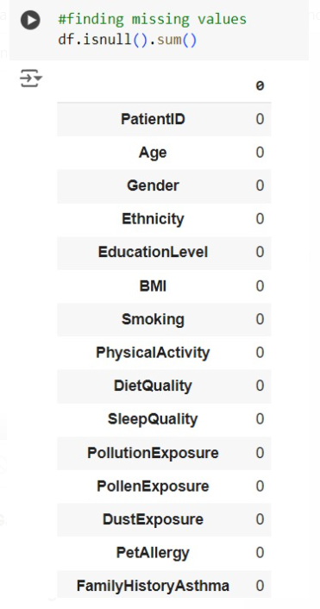
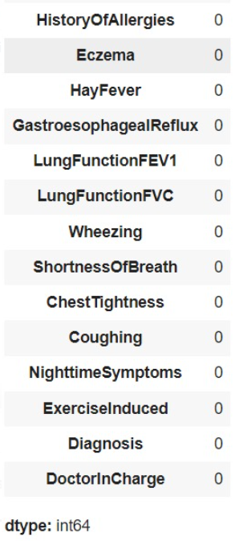
Checking for missing values
There are no missing values in the dataset

Slide 28
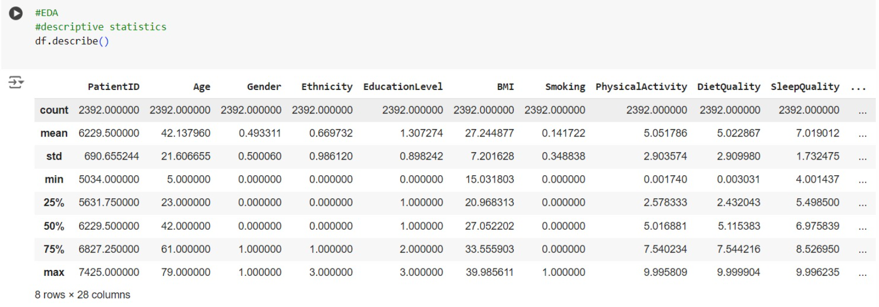
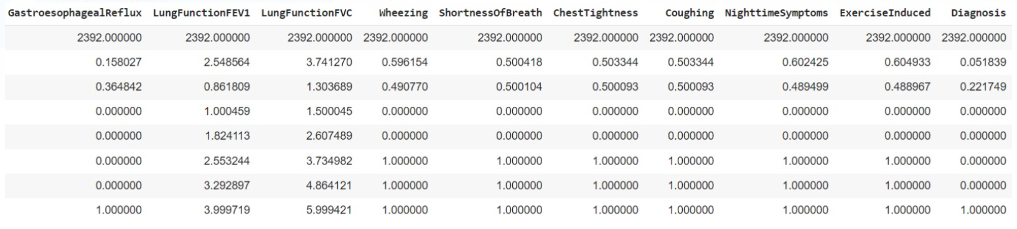
Descriptive statistics
Age has a very high standard deviation and maximum value is 79

Slide 29
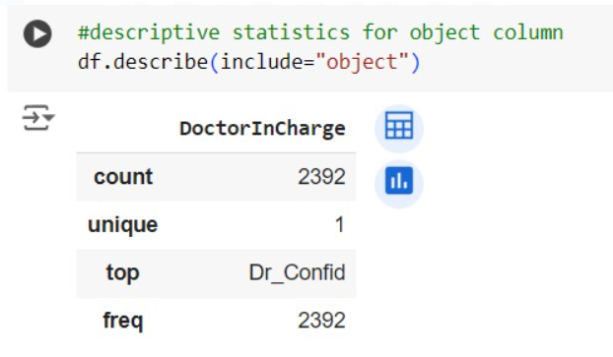
count: 2392 - This indicates that there are 2392 non-null values (entries) in the "DoctorInCharge" column.
unique: 1 - This means that there is only one unique value (category) present in the entire column.
top: Dr_Confid - This is the most frequently occurring value (mode) in the column, which is "Dr_Confid".
freq: 2392 - This shows that the value "Dr_Confid" appears 2392 times, implying that all entries in the column have the same value.
Outliers:
Since all values in the "DoctorInCharge" column are identical ("Dr_Confid"), there are no outliers present.

Slide 30
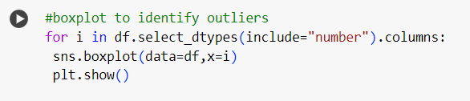
There are no outliers.

Slide 31
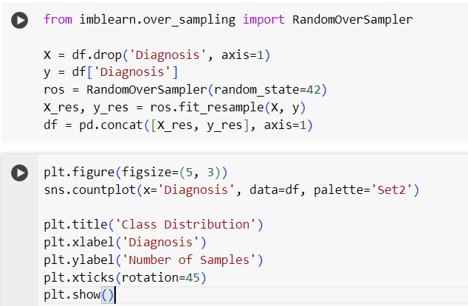
Class Imbalance

Slide 32
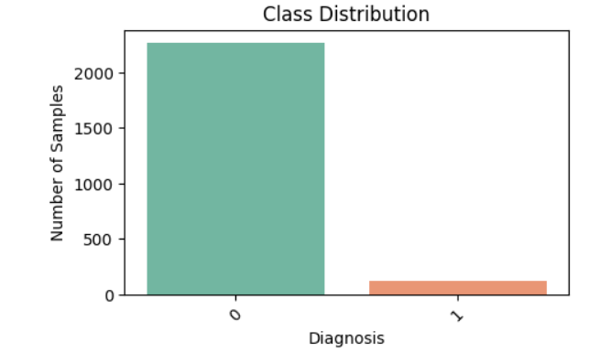
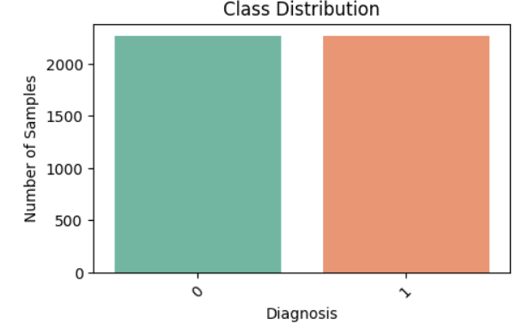
Unbalanced
Balanced

Slide 33
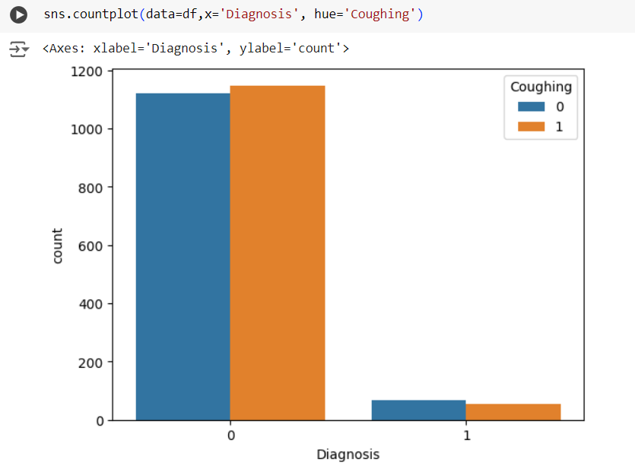
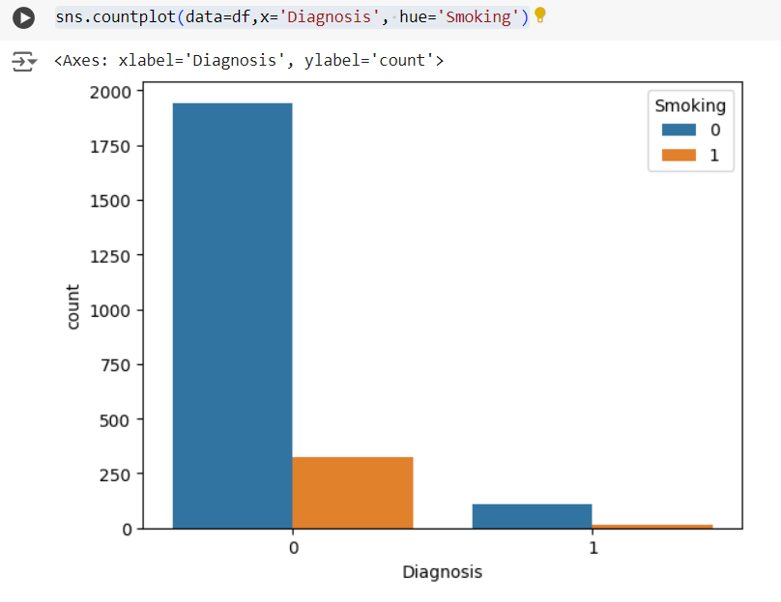
Visualisation

Slide 34
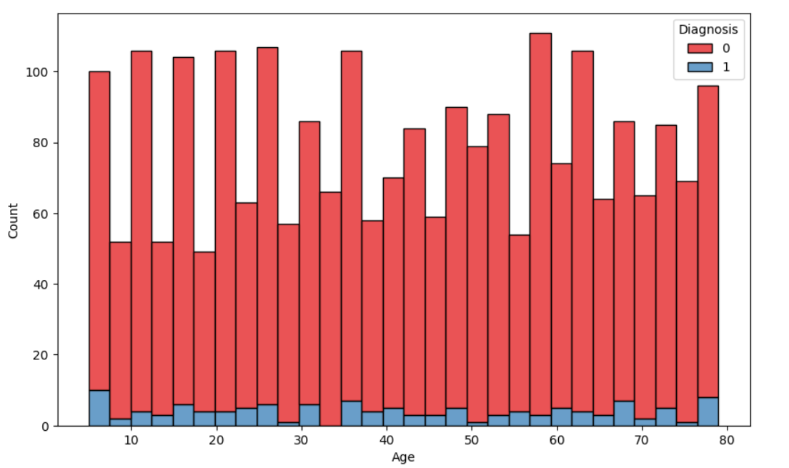
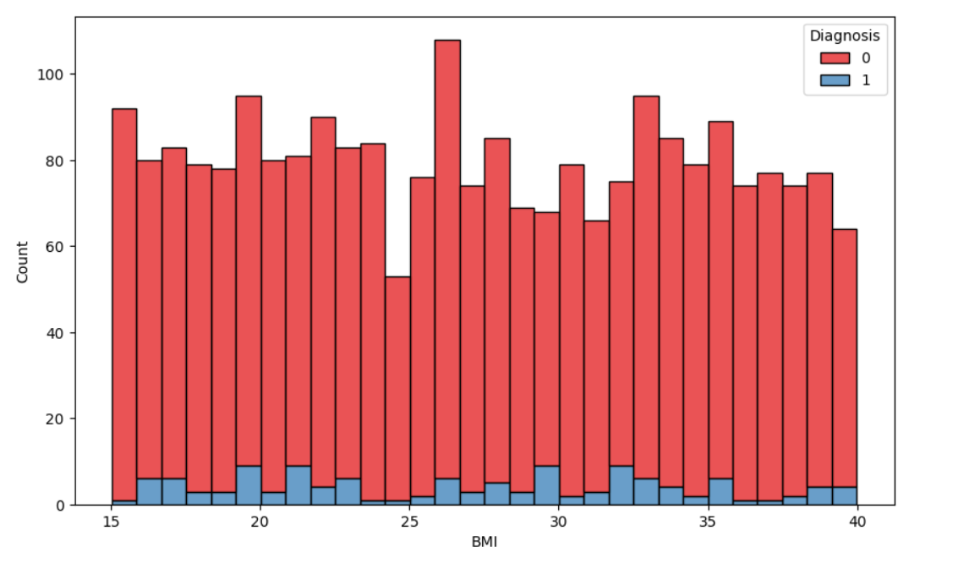

Slide 35
RANDOM FOREST
Supervised learning technique
Based on the concept of ensemble learning, which is a process of combining multiple classifiers to solve a complex problem and to improve the performance of the model.
Works by constructing a collection of decision trees
Random forest takes the prediction from each tree and based on the majority votes of output, it takes the final output.

Slide 36
How does RF algorithm work?
Random forest select random K data points and features from the training set.
Build the decision trees associated with the selected data points (Subsets).
Build N number of decision trees .
Each decision tree will generate output.
For new data points, find the output of each decision tree, and assign the new data points to the category that wins the majority votes.
Random forest handles complex datasets
Stability arises because the result is based on majority voting.

Slide 37
Pseudocode
1. Input:
- Training dataset with N samples and M features.
- Number of trees to create: T.
- Number of features to randomly select at each split: F.
2. Initialize an empty list called 'forest' to store the trees.
3. For each tree (from 1 to T):
a. Create a random sample of the training data (some samples may repeat).
b. Build a decision tree:
i. At each decision point in the tree:

Slide 38
- Randomly pick F features.
- Find the best feature and split point among the F features to split the node - Split the node into two child nodes based on the selected split point.
ii. Keep splitting until the tree is fully grown or meets some stopping condition
(like a max depth or minimum samples).
c. Add this decision tree to the 'forest'.
4. To make a prediction for a new sample x:
a. Let each tree in the forest make a prediction.
b. The final prediction is the one that most trees agree on (majority vote).

Slide 39
SUPPORT VECTOR MACHINE
Supervised learning technique.
SVM finds a hyperplane that best separates the two classes.
There can be infinite number of hyperplanes passing through a point and classifiying the classes perfectly.
The best hyperplane is the one with maximum marginal distance.
The main objective of the SVM algorithm is to find the optimal hyperplane in an N-dimensional space that can separate the data points in different classes.
The dimension of the hyperplane depends upon the number of features.

Slide 40
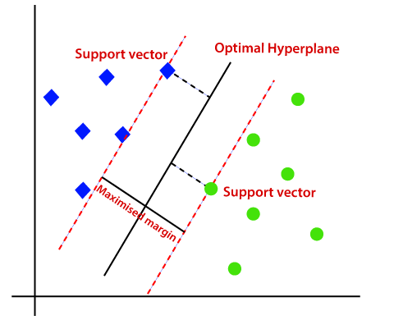
There can be multiple lines/decision boundaries to segregate the classes in n-dimensional space, but we need to find out the best decision boundary that helps to classify the data points.

Slide 41
SVM chooses the extreme points/vectors that help in creating the hyperplane. These extreme cases are called as support vectors, and hence algorithm is termed as Support Vector Machine.
The SVM algorithm has the characteristics to ignore the outlier and finds the best hyperplane that maximizes the margin. SVM is robust to outliers.
So the margins in these types of cases are called soft margins.
Non-Linear SVM : Non-Linear SVM can be used to classify data when it cannot be separated into two classes by a straight line (in the case of 2D). By using kernel functions, nonlinear SVMs can handle nonlinearly separable data. The original input data is transformed by these kernel functions into a higher-dimensional feature space, where the data points can be linearly separated. A linear SVM is used to locate a nonlinear decision boundary in this modified space.

Slide 42

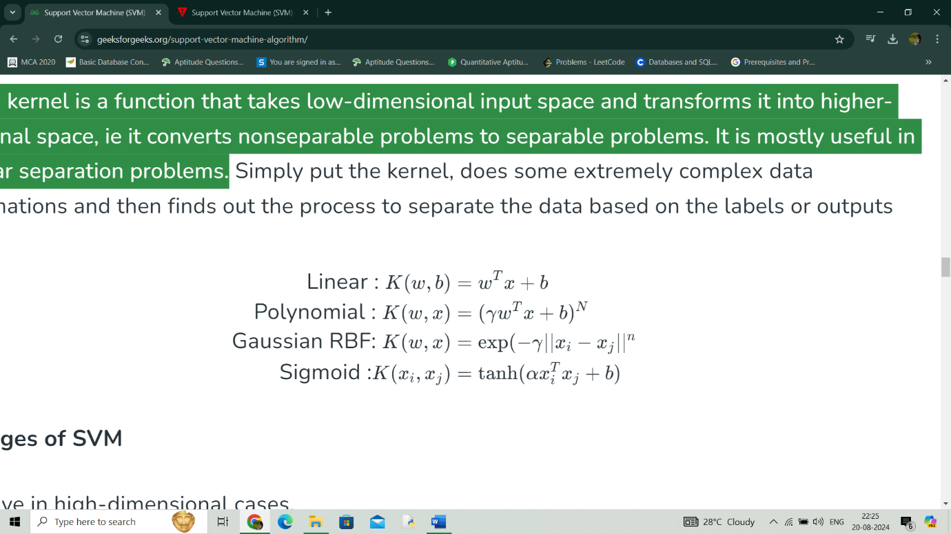
The SVM kernel is a function that takes low-dimensional input space and transforms it into higher-dimensional space, i.e. it converts nonseparable problems to separable problems.
Some commonly used kernel functions are,

Slide 43
How Support Vector Machine works?
Gather dataset which consists of feature inputs and corresponding outputs.
Represent each data point as a vector in a multi-dimensional space, where each dimension corresponds to a feature of the data.
Find the hyperplane that maximizes this margin, ensuring the best possible separation between the two classes.
If the data is not linearly separable, the original feature space is mapped into a higher-dimensional space by using kernel trick where a linear hyperplane can separate the classes.
Find the weights and bias that define the hyperplane by maximizing the margin and minimizing the classification errors.
Once trained, the SVM model can classify new data points. For each new point, the model checks on which side of the hyperplane the point falls.

Slide 44
Pseudocode
1. Initialize Parameters:
- Set the regularization parameter C.
- Initialize weights w and bias b to 0 or small random values.
2. Repeat for a fixed number of iterations:
a. For each data point (xi, yi) in the training set:
i. Calculate the decision function: f(xi) = w * xi + b
ii. If the data point is misclassified (i.e., yi * f(xi) < 1):
- Update weights: w = w + C * yi * xi
- Update bias: b = b + C * yi

Slide 45
3. Prediction:
- For a new data point x_new, compute:
f(x_new) = w * x_new + b
- Return the predicted class:
if f(x_new) >= 0, return +1
else return -1

Slide 46
Decision Tree
Decision Tree is a Supervised learning technique that can be used for both classification and Regression problems, but mostly it is preferred for solving Classification problems. It is a tree-structured classifier, where internal nodes represent the features of a dataset, branches represent the decision rules and each leaf node represents the outcome.
In a Decision tree, there are two nodes, which are the Decision Node and Leaf Node. Decision nodes are used to make any decision and have multiple branches, whereas Leaf nodes are the output of those decisions and do not contain any further branches.
The decisions or the test are performed on the basis of features of the given dataset.
It is a graphical representation for getting all the possible solutions to a problem/decision based on given conditions.
It is called a decision tree because, similar to a tree, it starts with the root node, which expands on further branches and constructs a tree-like structure.
In order to build a tree, we use the CART algorithm, which stands for Classification and Regression Tree algorithm.
A decision tree simply asks a question, and based on the answer (Yes/No), it further split the tree into subtrees.

Slide 47
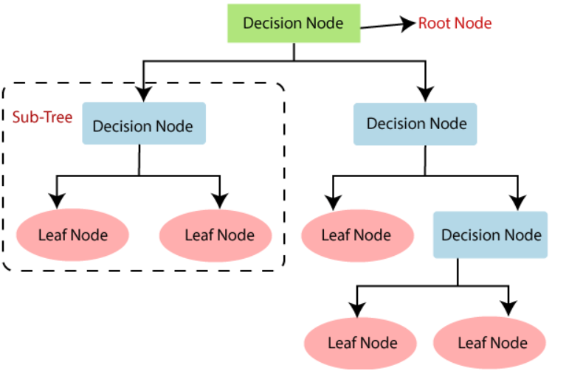
General Structure

Slide 48
Working
Splitting: At each node, the algorithm assesses the input features and decides the best way to split the data based on a specific criterion (like Gini impurity or entropy) that aims to maximize the separation of classes or minimize error.
Traversing: The decision tree traverses down from the root node to the leaf nodes based on the feature values of the input data. Each decision point (node) corresponds to a specific test on an input feature.
Leaf Nodes: Once a decision path is taken, one reaches a leaf node which provides the output prediction or class label based on the majority class of instances that reached that leaf.

Slide 49
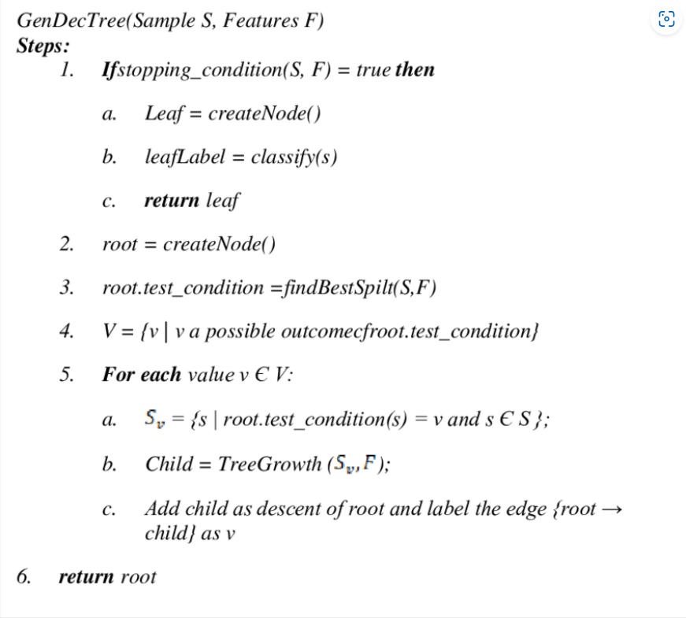
Pseudocode

Slide 50
Packages and Built-in Functions Used
Pandas
- read_csv()
- head()
- shape()
- info()
- value_counts()
- isnull()
- describe()
- tail()

Slide 51
Matplotlib
- show()
- xlabel()
- ylabel()
Seaborn
- boxplot()
- countplot()
- scatterplot()
Numpy

Slide 52
PROJECT PIPELINE
Exploratory
Data Analysis
Data
Preprocessing
Splitting
Dataset
Test
Data
Train
Data
Dataset
Collection
Build Model
( RF, DT, SVM )
Best
Model
Input
Asthma Classification

Slide 53
TIMELINE
Sprint release 1
- Model building using Random Forest
Sprint release 2
- Model building using Decision Tree
- Model building using Support Vector Machine
Sprint Release 3
- Interface design
- deployment

Slide 54
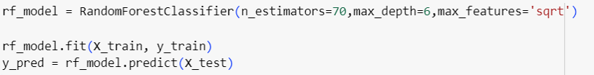
SYSTEM DESIGN
Model Training
The dataset is divided into training and testing data.
Random Forest
A Random Forest Classifier, which is an ensemble learning method based on multiple decision trees is used to train the model. The model consists of 70 decision trees. The maximum depth of each tree is limited to 6 levels. The number of features considered for splitting at each node is the square root of the total number of features.

Slide 55
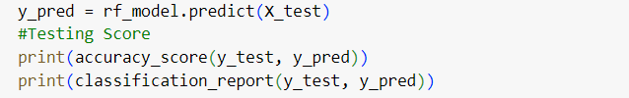
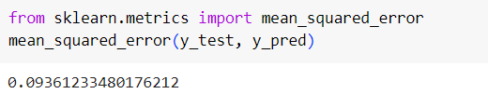
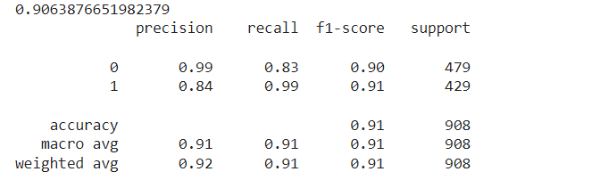
MODEL EVALUATION
0.9321940463065049
The model achieved an accuracy of 93.21% on the training data.
The model achieved an accuracy of 90.63% on the testing data and mean squared error is 0.09.

Slide 56
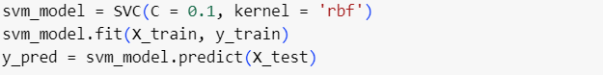
Support Vector Machine
Support Vector Machine is used to train the model. The C parameter is the regularization parameter. Smaller C values (like 0.1) create a more flexible decision boundary by allowing some misclassifications on the training data, which can help prevent overfitting and generalize better to the test data. The Radial Basis Function (RBF) kernel was selected for this model. The RBF kernel is effective for non-linear decision boundaries, allowing the model to capture complex relationships between features.
0.818632855567806
The model achieved an accuracy of 81.86% on the training data.

Slide 57
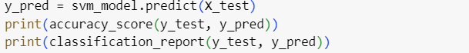
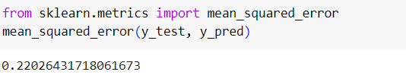
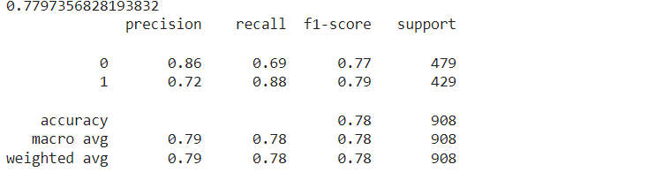
MODEL EVALUATION
The model achieved an accuracy of 77.97% on the testing data and the mean squared error is 0.22.

Slide 58
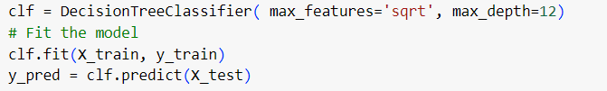
DECISION TREE
The model will consider the square root of the total number of features when looking for the best split at each node. This is commonly used to reduce overfitting. max_ depth=12 limits the maximum depth of the tree to 12. Controlling the depth helps prevent overfitting by limiting how complex the tree can become.
0.8784454244762955
The model achieved an accuracy of 87.84% on the training data

Slide 59
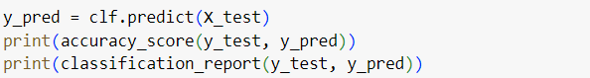
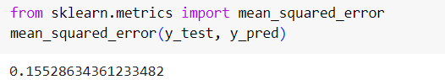
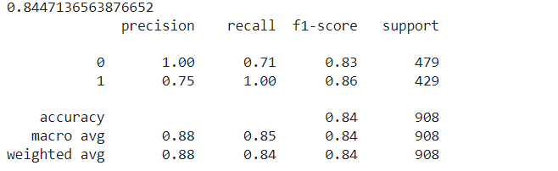
MODEL EVALUATION
The model achieved an accuracy of 84.47% on the testing data and the mean squared error is 0.15.

Slide 60
THANK YOU

